Slide 1

Video Game Analysis Report

Slide 2
OUTLINE
Introduction
Dashboard Overview
Key Insights
Summary
Recommendations
Notes:
Today's agenda will be as follows:
We will recap the overall project to give a high level understanding of the problem statement we're tackling and the specific requirements.
We will dive into the specific problem that we, the Data Analytics team have been focusing on and will give some background of the task.
After introducing the problem, I will go over the team responsible from our side in tackling this task.
I will then go over the process that we followed to complete this task, so that you have complete clarity of how we tackled each tasks.
Finally, I will go over all the results and I will present them as a series of insights and visualisations from our analysis.
To wrap up, I will summarize and open for any questions.

Slide 3
Introduction
This analysis aims to explore video game sales data with a focus on identifying trends and insights. The study will include the following key objectives :
Global Sales Analysis: Examine the top most-sold games globally to identify sales patterns and performance.
Genre and Platform Analysis: Analyze video game sales based on genres and platforms to understand preferences and trends
The process undertaken to achieve this includes:
•Understanding the data
•Data Cleaning
•Data Analysis
•Data Visualization
•Data Interpretation

Slide 4

Dashboard Overview
Purpose
The purpose of this dashboard is to analyze video game sales trends across various regions, platforms, genres, and publishers, enabling stakeholders to understand market dynamics and identify top-performing segments in the gaming industry.
Tools:
Jupyter Notebook - Exploratory data analysis and cleaning.
Google Data Studio – Preparation of interactive dashboard.

Slide 5
Key insights
North America has the highest cumulative sales, contributing significantly to the global sum of 8,901 million
units
The top-selling game is "Wii Sports", while Nintendo emerges as the leading publisher.
Among platforms, PlayStation 2 dominates, and Action is the most popular genre globally.
Sales trends indicate a peak in the mid-2000s across most regions.
Certain genres like action, sports, and shooter games tend to dominate sales and user engagement

Slide 6

1,290.09
797.08
8,901.03
4,384.41
2,429.45
Total Sales in Japan(N’m)
Total Sales in North America (N’m)
Total Sales in Europe(N’m)
Total sales in the rest of the world(N’m)
Global Sales (N’m)

Slide 7

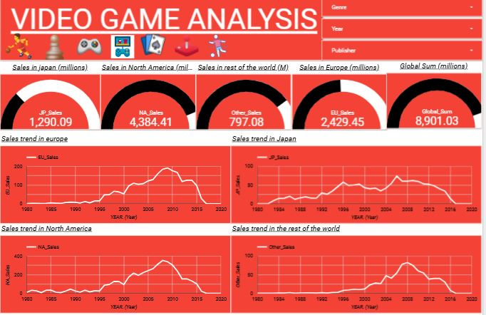


Slide 8
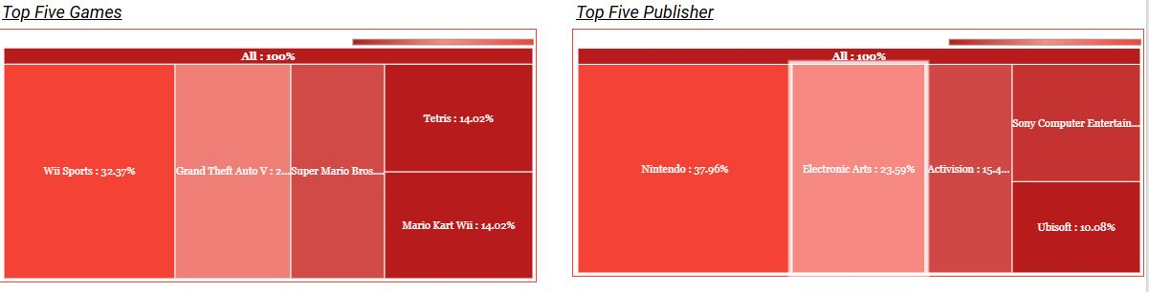

Slide 9
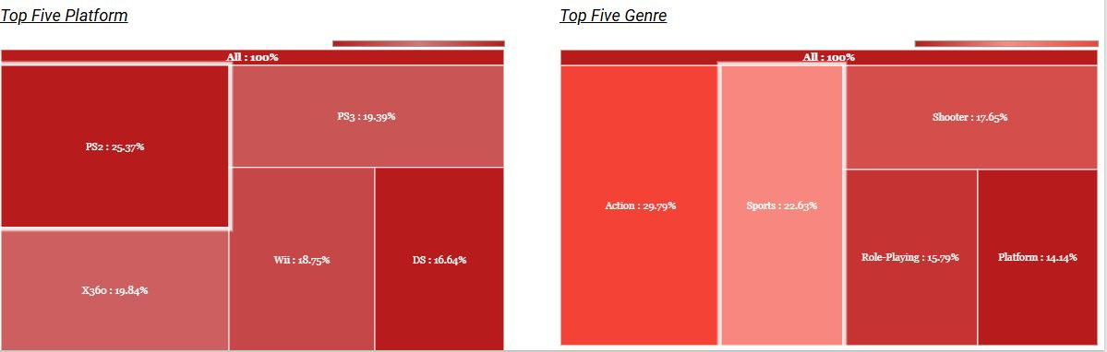

Slide 10
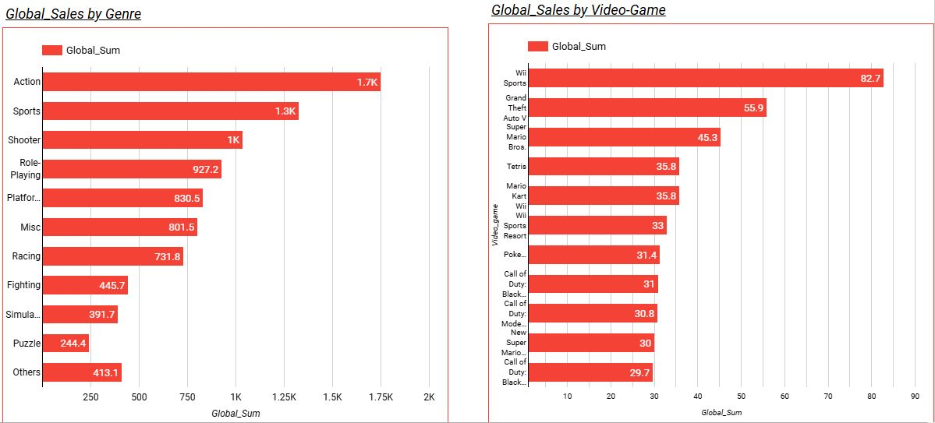

Slide 11
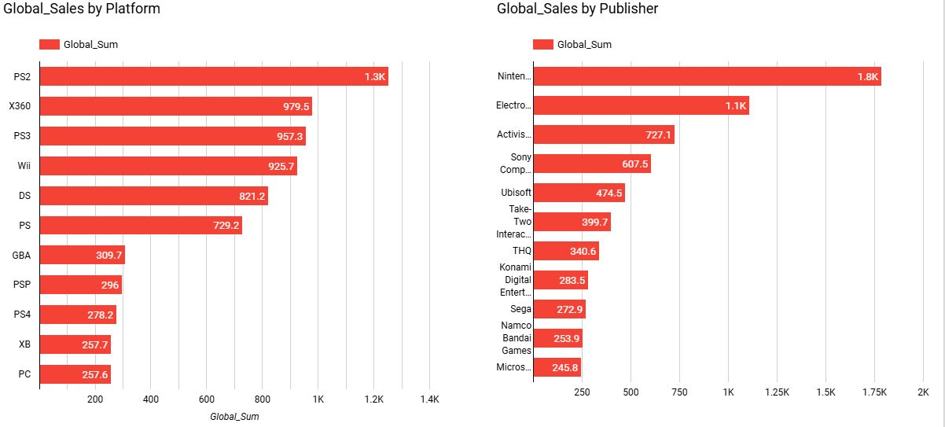

Slide 12
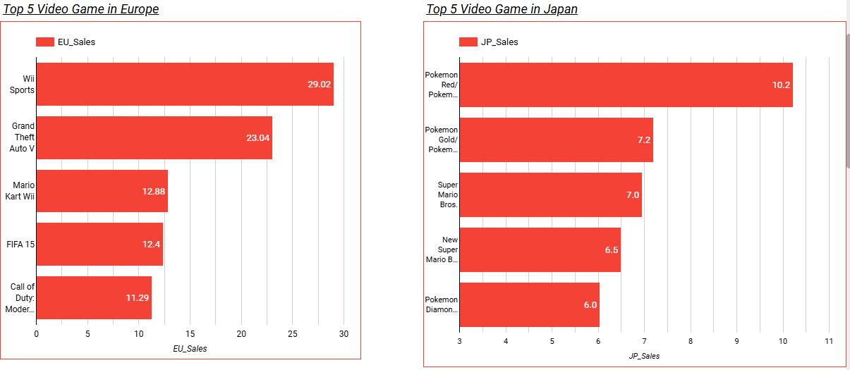

Slide 13
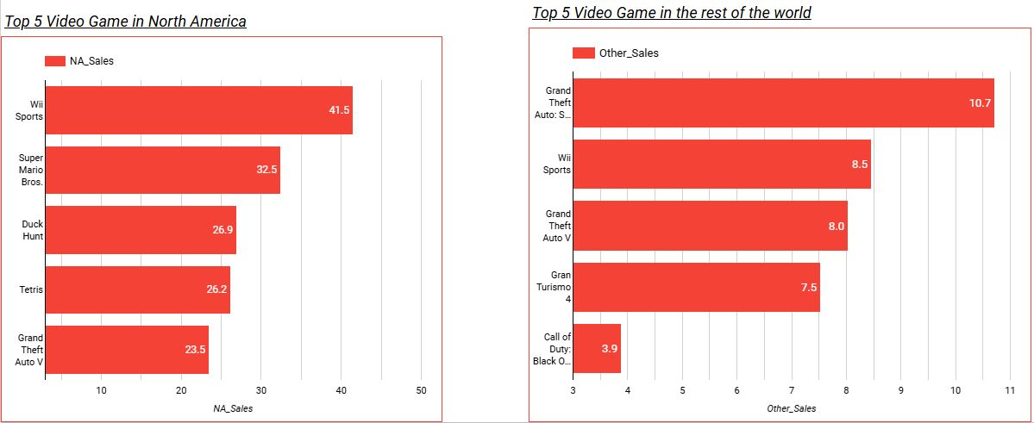

Slide 14
Action is the most popular video game genre.
Summary
Nintendo is the most popular video game publisher.
Sales trends indicate a peak in the mid-2000s across most regions.

Slide 15
Recommendations
Game Companies should focus on platforms with the highest user engagement for their target genre
Companies should avoid heavy investment in declining genres unless there's a unique value proposition.
North America is the dominant market with 4,384.41 million units sold, contributing the largest share to global sales. This suggests that video game publishers and developers should prioritize this region in marketing and distribution strategies.
Launch new games or run promotional campaigns during key holiday periods to maximize revenue.

Slide 16
.
Recommendations
Allocate significant resources to marketing and distribution in North America and Europe due to their dominant sales figures
Partner with influencers and esports events to drive engagement in these regions.
Re-release or remaster classic games from the late 1990s and 2000s, particularly in regions where sales peaked during that time.
Target the "rest of the world" category with affordable pricing models, localization efforts, and mobile gaming initiatives

Slide 17

Thank you!
Any Questions

